Slide 1
Development Of A Clinical Decision-support And Self-management System For Patients With Diabetes Mellitus
Subtitle: Academic Feasibility Study & System Architecture
CASE STUDY: SIR ALBERT COOK HOSPITAL,SENTEMA ROAD ,KAMPALA UGANDA
Presenter: ALABA RITA SOPHIE
Program: Diploma in Software Engineering
Institution: ISBAT University, Kampala
SUPERVISOR: MR.TOBIAS KAKOOZA
Academic Year: 2025 / 2026

Slide 2
Statement of the Problem
Incomplete Patient Logs: Patients heavily rely on memory or paper logbooks, leading to missing timestamps, illegible entries, and unreliable history during clinic visits.
Delayed Triage & Clinical Overhead: Clinicians lose consultation time manually reviewing fragmented paper records rather than focusing on patient care.
Unnoticed Dangerous Trends: Without real-time automated alerts, critical hypoglycemic or hyper-glycemic episodes go undetected between routine hospital appointments.
Prescribing Risks: Absence of real-time clinical decision-support increases the risk of dosage errors, drug-allergy conflicts, or prescribing without verified vital signs.
Data Disconnect: Lack of a centralized digital link between patient home monitoring and doctor-side clinical triage.

Slide 3
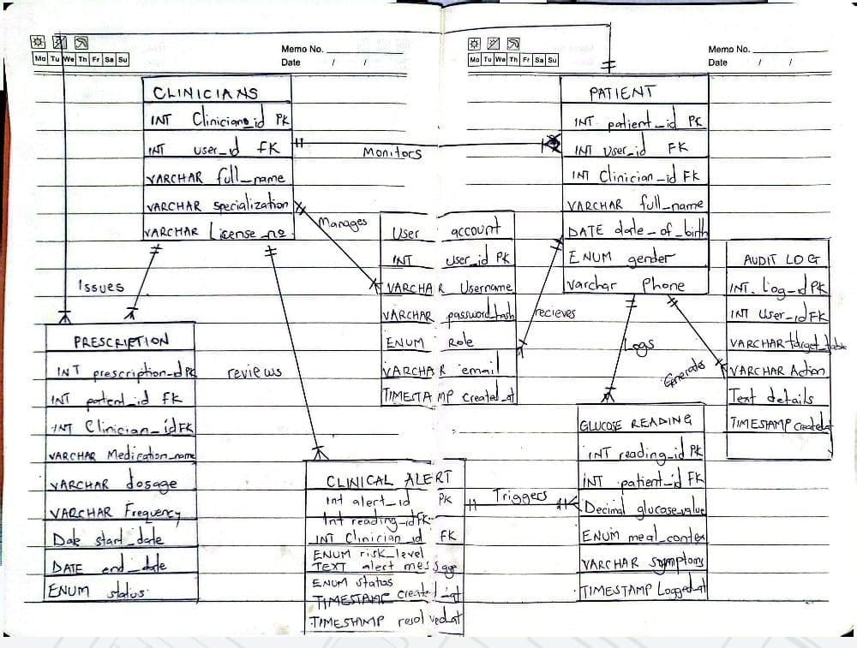
Database design
graph TD
CLINICIAN[CLINICIAN]
PATIENT[PATIENT]
READING[GLUCOSE READING]
ALERT[CLINICAL ALERT]
PRESCRIPTION[PRESCRIPTION]
CLINICIAN -- "1 : M (monitors)" --> PATIENT
PATIENT -- "1 : M (logs)" --> READING
READING -- “M :1 (triggers)" --> ALERT
CLINICIAN -- "1 : M (reviews)" --> ALERT
CLINICIAN -- "1 : M (issues)" --> PRESCRIPTION
PATIENT -- "1 : M (receives)" --> PRESCRIPTION

Slide 4
Projected Scope
In-Scope (System Capabilities)
Patient Module: Mobile/web interface for logging blood glucose, meal context (fasting, post-meal), symptoms, and viewing visual trends.
Clinician Triage Dashboard: Real-time risk prioritization (low / moderate / high / critical), historical patient trends, and prescription management.
CLINICAL DECISION-SUPPORT ENGINE: Automated rule checking (e.g., Glucose < 70 mg/dl or > 180 mg/dl, BP > 160/100 mmhg) and data reliability scoring.
Workflow Enforcement: Blocks prescription generation until nurse-recorded vitals are submitted.
Security & Governance: Role-based access control (RBAC) and immutable, timestamped audit logging for system edits.
Out-of-Scope (Future Phases)
Direct hardware-level bluetooth pairing with proprietary glucometers (phase 1 uses manual entry).
Fully automated insulin pump delivery control.
Third-party insurance claims and billing software integration.

Slide 5
Output from the Feasibility Study
Feasibility Domain | Findings & Data Points | Status
Economic Feasibility | Built using a cost-effective, open-source technology stack (PHP/MySQL) with zero expensive software licensing fees. It leverages existing hospital desktop computers and patient smartphones, yielding a high return on investment (ROI) by reducing manual triage time and costly emergency hospitalizations from unmanaged diabetes complications. | Feasible
Operational Feasibility | 100% of clinicians and nurses confirmed that automated threshold alerts, allergy checking, and pre-prescription vital sign enforcement would significantly improve clinical safety. | Feasible
Technical Feasibility | Existing hospital infrastructure (desktop computers, Wi-Fi network, basic digital literacy) is sufficient to deploy web/desktop-based interfaces. | Feasible
Workflow Need | Over 80% of clinical staff report encountering missing visit history or delayed vitals during peak hours, validating the need for direct digital handover. | Feasible
Organizational Support | Hospital administration confirmed willingness to participate in prototype testing using sample datasets. | Feasible

Slide 6
Conclusion
Summary: The proposed clinical decision-support and self-management system solves critical gaps in diabetes management by connecting patient self-monitoring with intelligent clinical triage.
Primary Value Delivered:
  Eliminates lost paper records and duplicate registrations.
  Reduces consultation prep time through automated trend dashboards.
  Enhances patient safety via real-time risk alerts and rule-based prescription checks.

